Slide 1
React JS
- Read document before going to class
- Practice under the instructor of teacher
- Evaluate by the projects
Getting started
Learn React
Notes:
Lecturer: Le Van Khanh
Fb: facebook.com/lekhanh.vn
Youtube: https://www.youtube.com/channel/UCFM3plFG0QUavW1FPfize7g

Slide 2
Introduction
Create user interfaces from components
Write components with code and markup
Add interactivity wherever you need it
Go full-stack with a framework
Use the best from every platform
Notes:
Reference:
https://react.dev/

Slide 3
React
The library for web and native user interfaces

Slide 4
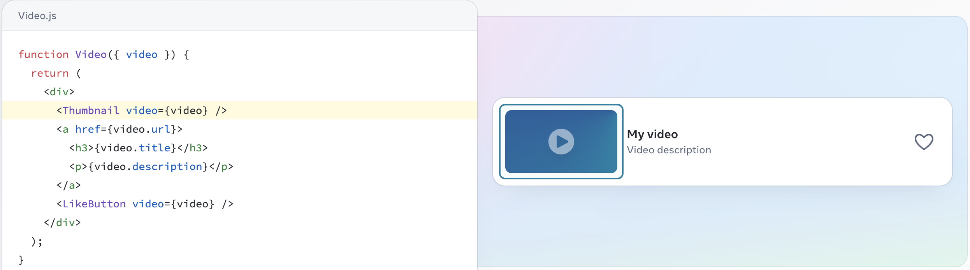
Create user interfaces from components
React lets you build user interfaces out of individual pieces called components. Create your own React components like Thumbnail, LikeButton, and Video. Then combine them into entire screens, pages, and apps.
Whether you work on your own or with thousands of other developers, using React feels the same. It is designed to let you seamlessly combine components written by independent people, teams, and organizations.

Slide 5
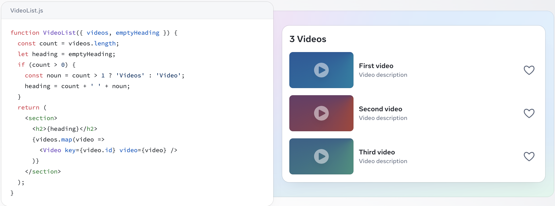
Write components with code and markup
React components are JavaScript functions. Want to show some content conditionally? Use an if statement. Displaying a list? Try array map(). Learning React is learning programming.
This markup syntax is called JSX. It is a JavaScript syntax extension popularized by React. Putting JSX markup close to related rendering logic makes React components easy to create, maintain, and delete.

Slide 6
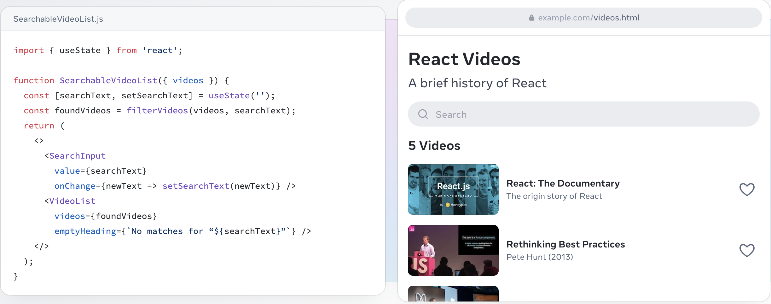
Add interactivity wherever you need it
React components receive data and return what should appear on the screen. You can pass them new data in response to an interaction, like when the user types into an input. React will then update the screen to match the new data.
You don’t have to build your whole page in React. Add React to your existing HTML page, and render interactive React components anywhere on it.

Slide 7
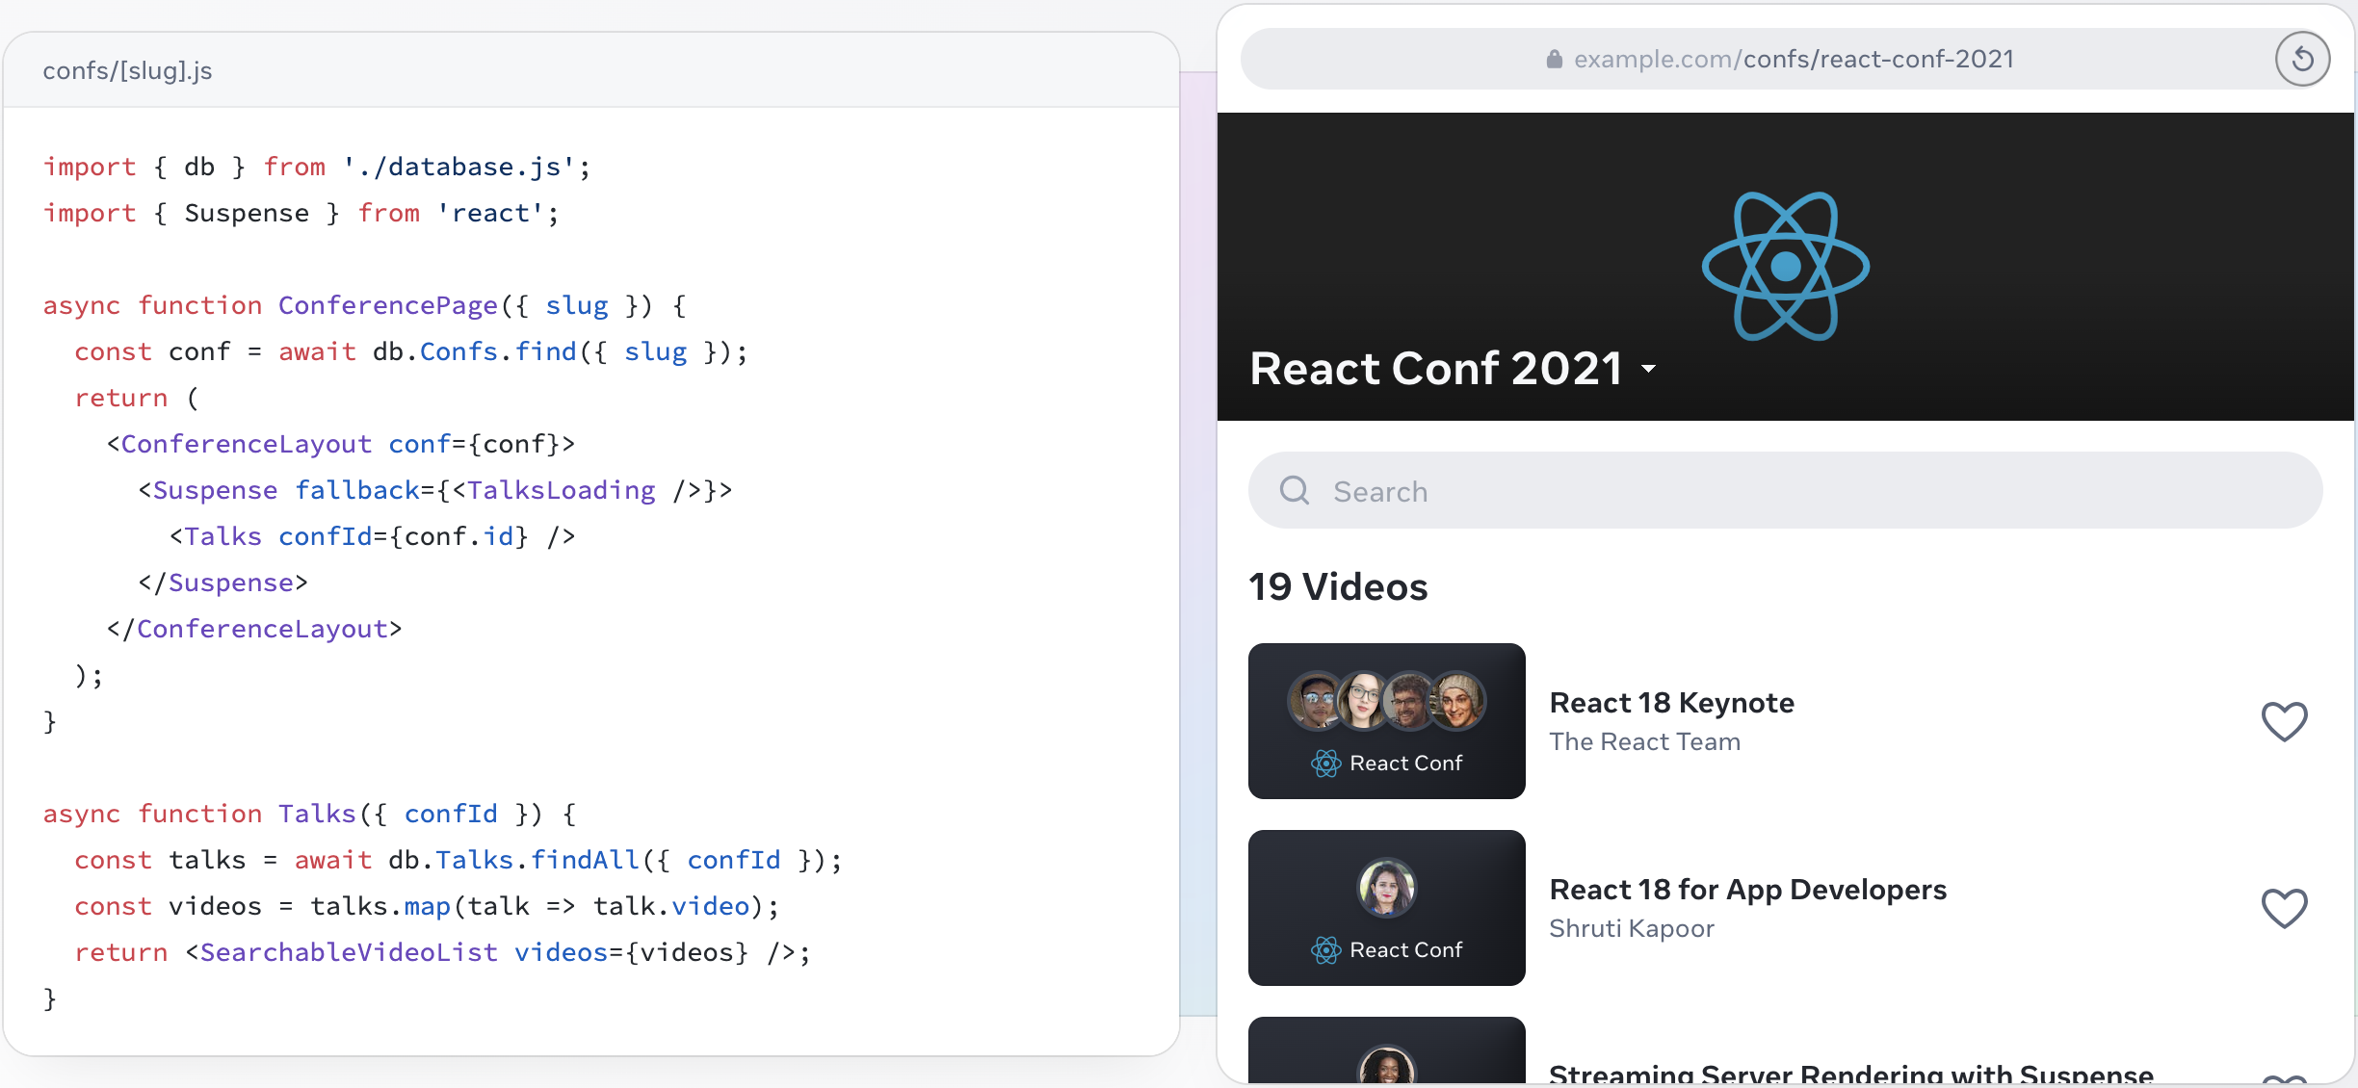
Go full-stack with a framework
React is a library. It lets you put components together, but it doesn’t prescribe how to do routing and data fetching. To build an entire app with React, we recommend a full-stack React framework like Next.js or Remix.
Notes:
React is also an architecture. Frameworks that implement it let you fetch data in asynchronous components that run on the server or even during the build. Read data from a file or a database, and pass it down to your interactive components.

Slide 8





Use the best from every platform
Stay true to the web
People expect web app pages to load fast. On the server, React lets you start streaming HTML while you’re still fetching data, progressively filling in the remaining content before any JavaScript code loads. On the client, React can use standard web APIs to keep your UI responsive even in the middle of rendering.
Go truly native
People expect native apps to look and feel like their platform. React Native and Expo let you build apps in React for Android, iOS, and more. They look and feel native because their UIs are truly native. It’s not a web view—your React components render real Android and iOS views provided by the platform.
With React, you can be a web and a native developer. Your team can ship to many platforms without sacrificing the user experience. Your organization can bridge the platform silos, and form teams that own entire features end-to-end.

Slide 9
Reference
React website: https://reactjs.org/
React Official Document: https://reactjs.org/docs/getting-started.html
Redux Official Document: https://redux.js.org/introduction/getting-started
React Redux Official Document: https://react-redux.js.org/introduction/quick-start

